Slide 1
Dashboard

Slide 2
Dashboard
Work Status

Slide 3
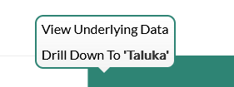
Dashboard
Progress Milestone

Slide 4
Dashboard
Work Status – “New” Schemes
Work Status – “Retro” Schemes

